Slide 1
Board Certification in Occupational Health Nursing

Slide 2
Why is Certification in a Nursing Specialty Important?
Institute of Medicine (IOM) Future of Nursing study found – “To ensure continuing safety of patients, IOM has recommended that healthcare providers be reevaluated and relicensed periodically”
Certification is the accepted method to validate knowledge, skills, and abilities
It is a mark of excellence that benefits the healthcare practitioner, public, consumer (patient, worker), and healthcare organizations

Slide 3
Reflection
When you are selecting a treating physician, do you prefer to find one who is board certified in the specialty?
Why wouldn’t it be the same for nursing?

Slide 4
Board Certification in Occupational Health Nursing by the American Board for Occupational Health Nurses (ABOHN)
ABOHN is the Sole certifying agency in the u.s. for Occupational Health Nurses
Certification examinations meet the rigorous standards for accreditation by the National Commission for Certifying Agencies (NCCA)
ABOHN mission is to promote a standard of excellence in occupational health nursing through certification

Slide 5
What are the Benefits of ABOHN Board Certification?
Demonstrates knowledge & competence
Indication of specialty expertise
Recognized by industry and regulatory agencies as mark of prestige
Other health & safety disciplines recognize as a sign of excellence
Significant personal & professional accomplishment
Leads to career advancement opportunities
Employers use certification in employment decisions
Demonstrates commitment to worker health and safety
Leads to increases in pay and promotions
Networking opportunities
Demonstrates commitment to lifelong learning

Slide 6
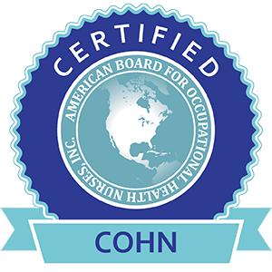
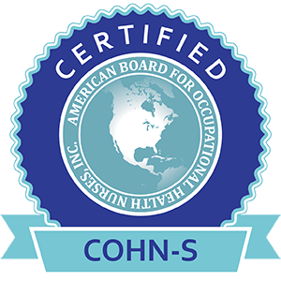
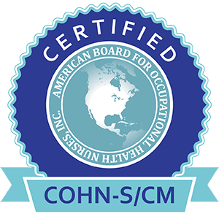
What Certifications are Offered by ABOHN?
Core Credentials
Certified Occupational Health Nurse (COHN)
Certified Occupational Health Nurse-Specialist (COHN-S)
Additional Specialty Credential
Case Management (CM)

Slide 7
Which certification exam is the right one for you?
ABOHN routinely conducts a Practice Analysis to ensure exams reflect current practice
Thorough analysis of OHN practice is conducted to assure examinations are reliable and valid
Recent practice analysis continues to demonstrate that the primary focus of COHN is clinical/patient care, and the primary focus of COHN-S is managerial/administrative
Both certifications are recognized as demonstration of excellence in the field

Slide 8
What are the eligibility requirements to take the examinations?
COHN
Active RN license
3000 hours experience in occupational health nursing within the past five years
COHN-S
Active RN license
3000 hours experience in occupational health nursing within the past five years
Bachelor or higher degree
CM (Additional Credential)
Currently active as a COHN or COHN-S
Additional 10 continuing education hours in case management

Slide 9
What are the costs to take the examinations?
COHN and COHN-S Application and Examination Fees
Category | Fee | Details
Application | $150.00 | Good for 90 days from the date of approval by the ABOHN office.
Examination | $400.00 | *Must be paid within 90 days of receipt of invoice from the ABOHN office and is good for 120 days.
Case Management Application and Examination Fees
Category | Fee | Details
Application | $150.00 | Good for 90 days from the date of approval by the ABOHN office.
Examination | $250.00 | *Must be paid within 90 days of receipt of invoice from the ABOHN office and is good for 120 days.

Slide 10
What are the requirements to maintain the credential?
Credential holder is responsible to continue an annual upkeep of their credential(s)
Annual Renewal fee for COHN/COHN-S is $150
Case management credential is an additional annual fee of $50
Recertification documentation is due every 5 years
Recertification includes the annual fee, documentation of required CEUs and hours working in OHN specialty

Slide 11
What additional value does ABOHN provide?
Job Postings – Specific to credential holders
Networking Opportunities
Facebook and LinkedIn
Resources
Online database directory of current certified OHNs
Career Guide
ABOHN Report Spring and Fall Issues
Weekly emails with updates and helpful information
Continuing Education Links
Digital Badges – includes your certification credentials, expiration date

Slide 12
Certification in Occupational Health Nursing
Recognizes expertise, knowledge, experience, and judgment in occupational health nursing
Benefits of certification include personal growth, career advancement, financial reward, and professional recognition
Board certification with ABOHN provides ongoing support, job postings, newsletters and other resources

Slide 13
Next Step: Invest in Yourself & Your Future!
Questions?
Contact ABOHN
Call: 630-789-5799
Website: www.abohn.org
Email: info@abohn.org

