Slide 1
Are you thinking about taking an ABOHN Certification Exam?
We want to help you prepare

Slide 2
We want to help you take the “scary” out of taking the exam
We hope you will consider the ideas in this presentation
If you can feel more prepared to take the exam, it may help you be successful.
Please start by following our 7 easy steps!

Slide 3
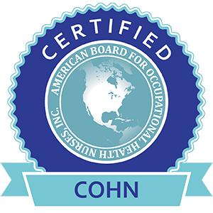
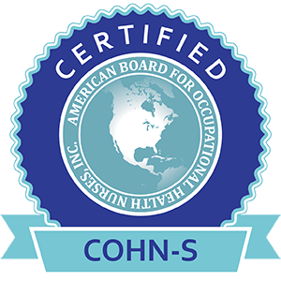
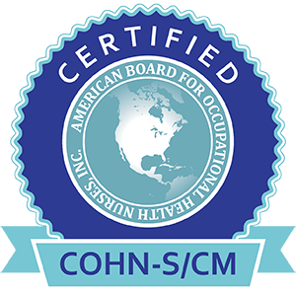
#1 What Certifications are offered by ABOHN?
Core Credentials
Certified Occupational Health Nurse (COHN)
Certified Occupational Health Nurse-Specialist (COHN-S)
Additional Specialty Credential
Case Management (CM)
#2 Select the exam that is right for you
Primary focus of COHN is clinical/patient care
Primary focus of COHN-S is Management/ Administrative

Slide 4
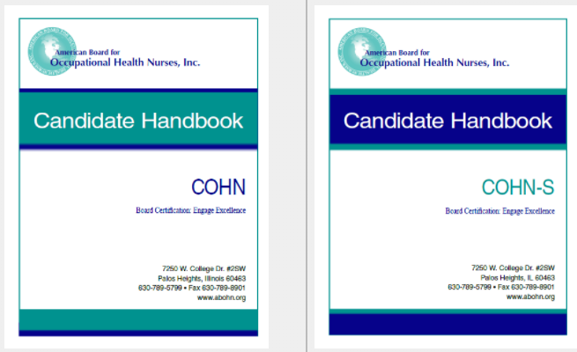
#3 Download the Exam Handbook
Go to www.ABOHN.org click Certifications
Click on a Handbook and download
The Handbook is filled with helpful information
Be sure to review the exam Domains and Blueprints!
These are the topics for the exam questions

Slide 5
#4 Recently certified OHNs identified what they did to prepare for the exam
64% of the OHNs report studying about 4-10 hours weekly
74% of the OHNs began studying several months before the exam

Slide 6
#5 OHNs rated these resources as helpful to very helpful:
77% Review Course
70% ABOHN CSATs
58% AAOHN Core Curriculum
Each person needs to identify their own study plan for success. For more information, go to https://www. abohn.org

Slide 7
#6 Enjoy the Benefits of Board Certification
Demonstrates your knowledge, competence & expertise
Recognized by industry and regulatory agencies as sign of excellence
Demonstrates your commitment to lifelong learning
Leads to career advancement opportunities
Employers use certification in employment decisions
Demonstrates your commitment to worker health and safety
Leads to increases in salary and promotions
Is a significant personal & professional accomplishment!
Recognized as mark of prestige by other health & safety disciplines

Slide 8
#7 Next Step: Invest in Yourself & Your Future!
Questions?
Please feel free to contact ABOHN. We want to help you be successful!
Call: 630-789-5799
Website: www.abohn.org
Email: info@abohn.org
Ready to take the exam? Review our presentation called “Ten Test Taking Tips”

